Slide 1
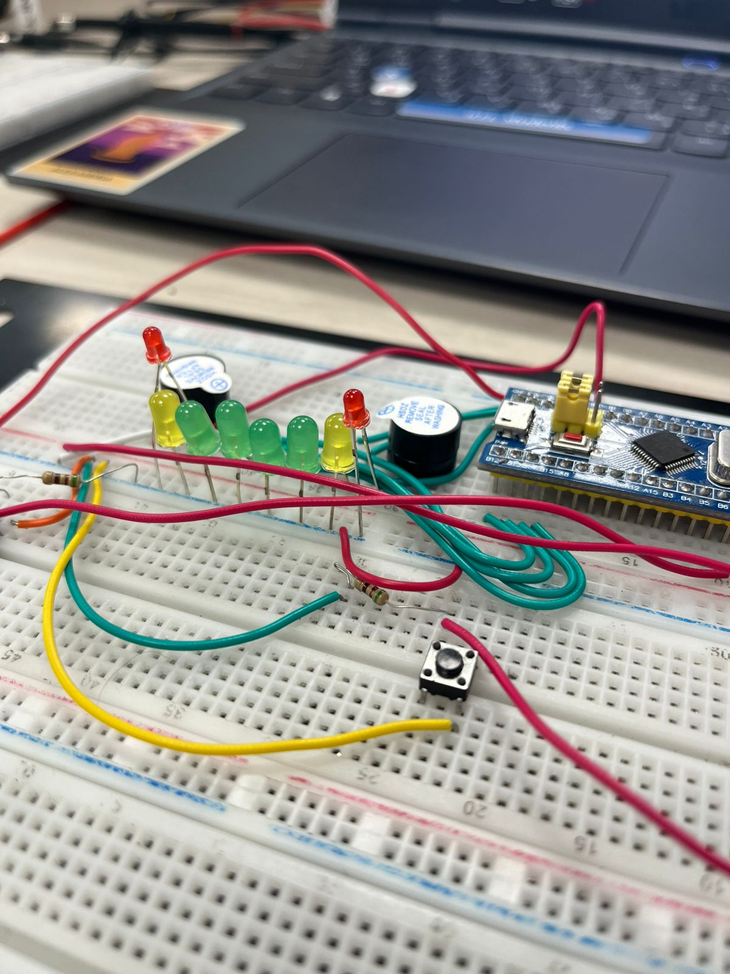
Pong Game
Presented by:
Jana Gamal 21-101104
Doha Bahaaeldin 21-101136
Aya Wael 21-101179
Youssef Yasser 21-101115
Farah Tamer 21-101050

Slide 2

Introduction
In this project, our team of computer engineering students embarks on a journey to recreate the thrill of this iconic game using the powerful STM32 microcontroller, vibrant LEDs, and responsive buttons. This project aimed to apply microcontroller programming skills and design principles to create an interactive and fun application.

Slide 3
Hardware Components
1
Versatile STM32
2
LEDs
3
Push Buttons
At the core of our Pong game is the STM32F103C8T6 microcontroller, a powerful and versatile chip.
Anarray of LEDs arranged to represent the ball. Each LED can be individually controlled to simulate the movement of the ball.
Two push buttons were used as input devices for the players to control the movement of their respective paddles.
3
Buzzer
3
Other Components
One buzzer: A buzzer is used to beep when someone out of the two players scores.
Resistors: Used to pull the buttons down when they are not pressed to ensure no garbage value gets to the buttons.
Breadboard and Jumper Wires: For building the circuit and connecting the components.
.

Slide 4



The Game’s Logic
Player Input
Responsive Gameplay
Collision Detection
The two push buttons in our Pong game serve as the primary input devices, allowing players to control the movement of their respective paddles and interact with the ball.
By monitoring the button presses through the STM32's GPIO pins, we are able to update the paddle positions in real-time, ensuring a seamless and responsive gameplay experience.
Our game logic carefully tracks the ball's position and the paddle's interactions, triggering changes in the ball's direction when a successful hit occurs, adding to the excitement and challenge of the game.

Slide 5
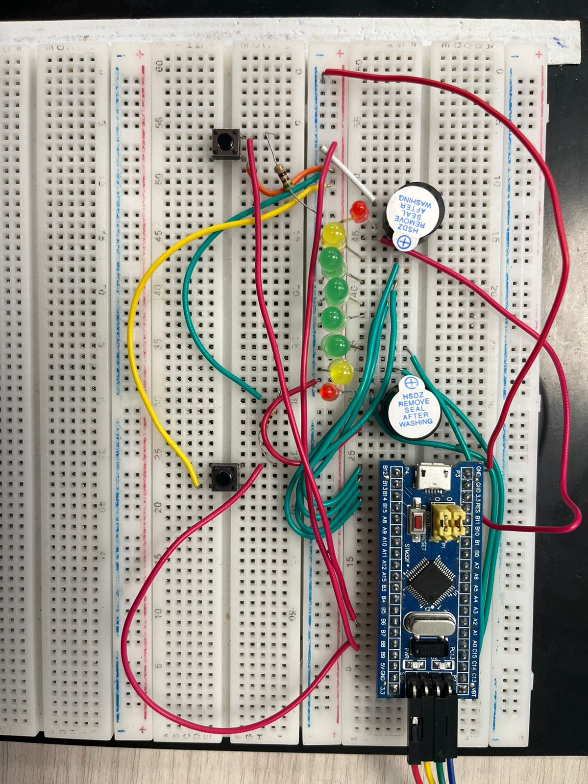
Bringing it All Together: Game Logic and Workflows
1
Initialization
The game starts by initializing the STM32 system and peripherals, setting up the necessary GPIO pins and configuring the system clock for optimal performance.
2
Game Loop
Once the system is ready, the game enters a continuous loop, where it monitors button inputs, updates the ball's position, and checks for collisions, creating a seamless and reactive gameplay experience.
3
Collision Detection
A crucial aspect of the game logic is the collision detection algorithm, which constantly checks the ball's position relative to the paddles and the game boundaries, triggering changes in the ball's direction and updating the score accordingly.

Slide 6

Conclusion
The Pong game project provided valuable experience in microcontroller programming. It successfully demonstrated the use of an STM32 microcontroller to create an interactive game using LEDs and buttons. Despite the challenges, the final implementation was successful and users found the game to be engaging and fun.

Slide 7
References
In this project, our team of computer engineering students embarks on a journey to recreate the thrill of this iconic game using the powerful STM32 microcontroller, vibrant LEDs, and responsive buttons.This project aimed to apply microcontroller programming skills and design principles to create an interactive and fun application.

